Slide 1
KNOWLEDGE DISCOVERY IN DATA: WORKFORCE PLANNING THROUGH VOLUME FORECASTING ON VIDEO-SHARING SERVICE INDUSTRY: A YOUTUBE CASE STUDY
FORTUNO, VERNIDETH

Slide 2
EXECUTIVE SUMMARY
The explosive growth of user-generated video content on platforms like YouTube, with an estimated 3.5 million videos uploaded daily, necessitates proactive strategies for managing user inquiries and complaints.
This paper proposes a forecasting model specifically designed to predict contact volume for YouTube, enabling the video streaming company to optimize resource allocation and workforce planning for efficient complaint resolution. By aligning staffing with anticipated demand, YouTube can enhance customer satisfaction and reduce operational costs.
This paper will use a 3-year horizon in identifying the trends and seasonality, if any, in the YouTube data. Naive, ETS (Error Trend Seasonal) method, ARIMA (Autoregressive Integrated Moving Average) model and ARIMAX will be considered in the forecasting and selection of the final forecast model. An ARIMAX model as a candidate model was considered to account launches and events that may affect forecasts. Comparison of forecasting accuracy for the four methods will be the basis for the final model.
Given the output of the final model, this paper will provide the company a better outlook on the demand needed for their workforce. With this, the company can supplement the needs thru hiring additional manpower or upskilling their current workforce to serve their customers.

Slide 3
TABLE OF CONTENTS
1
Introduction
Data and Methods
4
Summary and Conclusion
Background
Business Problem
Analytics Problem
Objectives
Scope and Limitations
2
5
Recommendation
Data Sources
Data Preprocessing
Analysis
Methods
Why the model
3
Results
6
References
Exploratory Data Analysis
Analysis of the Results

Slide 4
1
INTRODUCTION

Slide 5



BACKGROUND
Social media is defined as "a collection of internet websites, services and practices that facilitate collaboration, community building, participation, and sharing" (Reynol et al., 2011).
People frequently use social media engines to express their views and thoughts, disseminate information about product launches and events and create articles and video content that may be of interest to users.
Despite the benefits of social media platforms, it also brought a surge of harmful content such as fake news, rumors, hate speech, aggression, and cyberbullying that can negatively impact mental health and lead to irreversible losses.
YouTube is a video-sharing and social media platform that allows users to upload, watch, and share videos. It offers a stage for content creators and a targeted audience for advertisers. To ensure a safe and respectful environment for all, social media platforms have systems for reporting, reviewing, and responding to user feedback. Users can submit their concerns and feedback to the platform through contact channels like chat or emails.
In this paper, we will investigate how YouTube capitalize the workforce given the contact volume of their platform. Forecast of volumes and its approach to staffing of company’s workforce to which talent allocation, job realignment, attrition, allocation of workload and even its cost savings in the business operations would be one viable impact.

Slide 6



BUSINESS AND ANALYTICS PROBLEM
How much volume of chat and email do we expect in the next 52 weeks?
How many people do we staff in the next 3 months and how we can account events and launches in these forecasts? (baseline and baseline + launches)
Analytics Problem
Best forecast model that will provide prediction in the next 52 weeks on the volume of email and chat.
Given additional variables, such as campaigns and launches, can we use ARIMAX in the forecast to consider these variables?
Business Problem

Slide 7






OBJECTIVES
Common Contact Volume Source
Model
Launches and Campaigns
Segregate chat and email to identify the complaints per medium
Identify final model from candidate models: Naïve, ETS, ARIMA and ARIMAX
Incorporate campaign and launches data in the forecast
Trend, Seasonality and Error
Comparison of different metrics
Determine Trend, Seasonality and Error that may influence contact volume of chat and email
Compare different metrics (RMSE, MAPE and AIC) to identify the best model

Slide 8
SCOPE AND LIMITATIONS
Platform subscribers of YouTube from June 2020-October 2023
Subscribers that are determined as English market / language
Data will include chat and email tickets only
Ticket refers to a unique record or identifier assigned to a specific inquiry or problem raised by YouTube platform users
Tickets may vary between technical issues and content-related problems to which it generates a distinct ticket for each submission
RStudio script will be set up to run results for forecasting models and accuracy metrics

Slide 9


REVIEW OF RELATED LITERATURES
ARIMAX
Workforce Planning
Literature Survey of different models for Call Center forecasting
Journals on ARIMAX
What is workforce planning?
Why is this important?
Shared pros and cons of different models to forecast expected calls
Journals on ARIMAX, predicting electricity demand and comparison of ARIMA vs. ARIMAX in the fashion industry
Workforce Planning in the context of Healthcare
Forecasting Accuracy Metric
Commonly used metrics for forecasting accuracy
Different setting of workforce planning, what are models and metrics used?

Slide 10
2
DATA AND METHODS

Slide 11
DATA AND METHODS
Data Sources
Data used in the analysis are tickets generated only by paid subscribers on the platform of YouTube
Out of 26 languages in the pipeline, the focus of forecasting will be English chat and email volumes, regardless of the subscriber’s country of origin.
Since a large volume of the tickets comes from English speakers, the dataset used focused on this language of support.
Separate forecasting will be done for email and another for chat since we are considering the turnaround time needed for these types of interaction.
In terms of resolving tickets, chats were resolved real time as live agents were accommodating the request while emails were resolved within the day.

Slide 12
DATA AND METHODS
Forecasting Process
Analyze available historical data in more detail
Set-up Model Validation
Create preliminary forecasting models
Use of test sets or cross-validation to calculate accurate metrics for determining final model
Create subseries plots Decompose data to determine how various components (ie trend, seasonality, error) impact the time series Create auto correlation (ACF) and partial auto correlation (PACF) plots Determine p and q based on ACF and PACF plots, value of d depends on stationarity. PACF plot – no. of spikes indicate order of autoregression while ACF indicate moving average | Train and test split , 80% - 20% split Training data schedule includes 156 weeks (January 2020 – December 2022) Test data schedule includes 44 weeks (January 2023 - October 2023) | Depending on data patterns and decomposition analysis, should include all potential models in the initial model building phase. Candidate models are Naïve, ETS, ARIMA and ARIMAX Determine if data transformation and/or differencing is needed. If needed, Box – Cox transformation and/or differencing to stabilize data and make it stationary | Good candidates for accuracy metric are Root Mean Square Error (RMSE), Mean Absolute Error (MAE), Mean Absolute Scaled Error (MASE) and Mean Absolute Percentage Error (MAPE). Other metrics that could be used are AIC (Akaike's Information Criteria) and/or BIC (Bayesian Information Criteria). Select models with lowest accuracy to determine best model. Considered one of the metrics for final model is MAPE since this effectively penalizes large errors.

Slide 13
DATA AND METHODS
Adding of Launches and Campaigns
Initially, project managers will provide all known events and/or developments that may potentially impact volumes (new launches, policy changes, process changes, etc.), as well as the estimated impact of those events and/or developments.
An estimated volume of impact per month will be provided and will be broken down into weeks through percentage representation.
To account for the launches and events, ARIMAX (AutoRegressive Integrated Moving Average with exogenous variables) and time series regression with input variables was used.
ARIMAX allows the integration of external factors (exogenous variables) into the time series model to capture their impact on the data of customer support tickets.
Forecast breakdown and usability to company
Forecast results will be assessed to break down projected ticket volumes from a weekly to a daily perspective.
Detailed breakdown aims to assist YouTube's contact centers in making informed staffing decisions.
By understanding daily variations in ticket submissions, the contact centers will be able to optimize headcount to ensure staffing levels to efficiently address user interactions each day.

Slide 14
DATA AND METHODS
Models used
Naïve model is a simple baseline that is useful for data with little trend or seasonality because it assumes that future values will reflect the most recent observation.
ETS (Error, Trend and Seasonal) model because it effectively captures and models the error, trend, and seasonality in time series data, making it a reliable choice for accurate predictions in various applications.
Using stepwise and disabling approximation, ARIMA model will be used thoroughly as it is intended for time series with trend and seasonality. It performs best when there is a trend or seasonality in the data.
By including exogenous variables, such as launches and events, the ARIMAX model will be highly considered as it improves accuracy over the ARIMA model. By enabling seasonality, ARIMAX will capture time series patterns influenced by outside factors. In the case of our data, these were the launches and events.

Slide 15
3
RESULTS

Slide 16
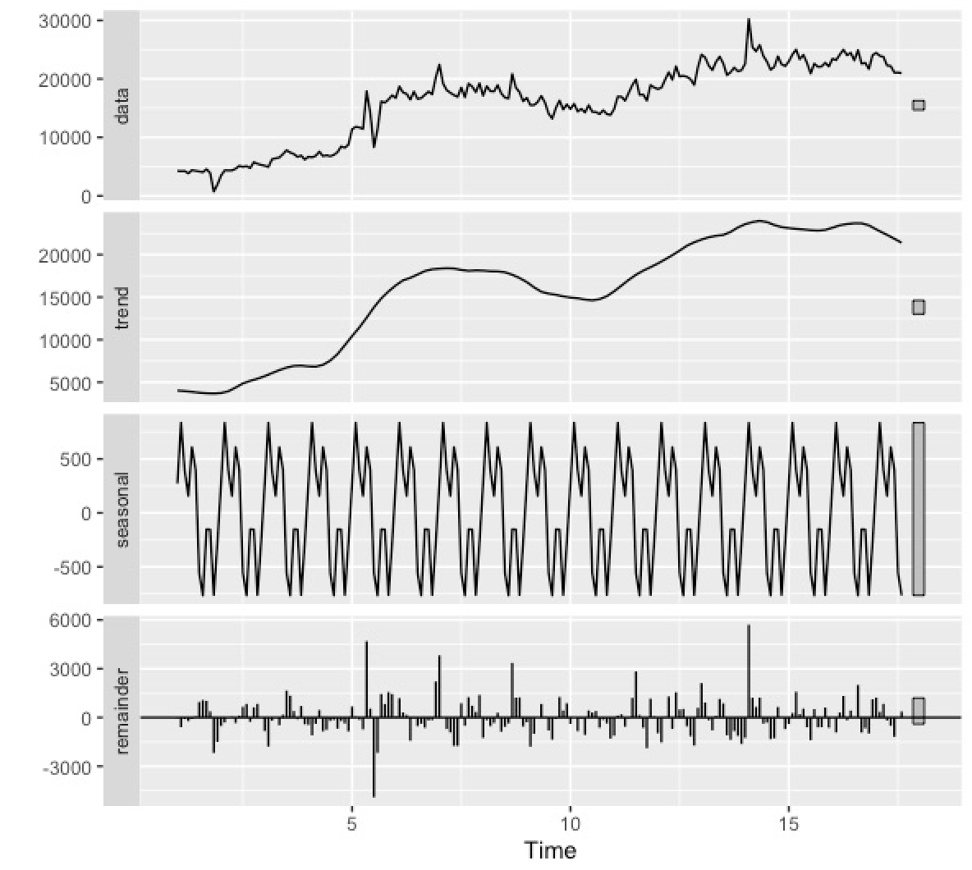
RESULTS – CHAT
Exploratory Data Analysis
Graph shows time series decomposition into three key components: seasonal, trend, and remainder.
Seasonal component shows fluctuations, indicating varying seasonal patterns throughout the year. For instance, in January, the seasonal effect is positive at 271.7584, while in July, it turns significantly negative at -558.3458 (check results from R Script chat run).
Trend component reveals an overall upward trajectory, showing a consistent increase over the months.
The remainder or outlier captures unexplained or random fluctuations in the data, highlighting periods with unexpected variations.

Slide 17
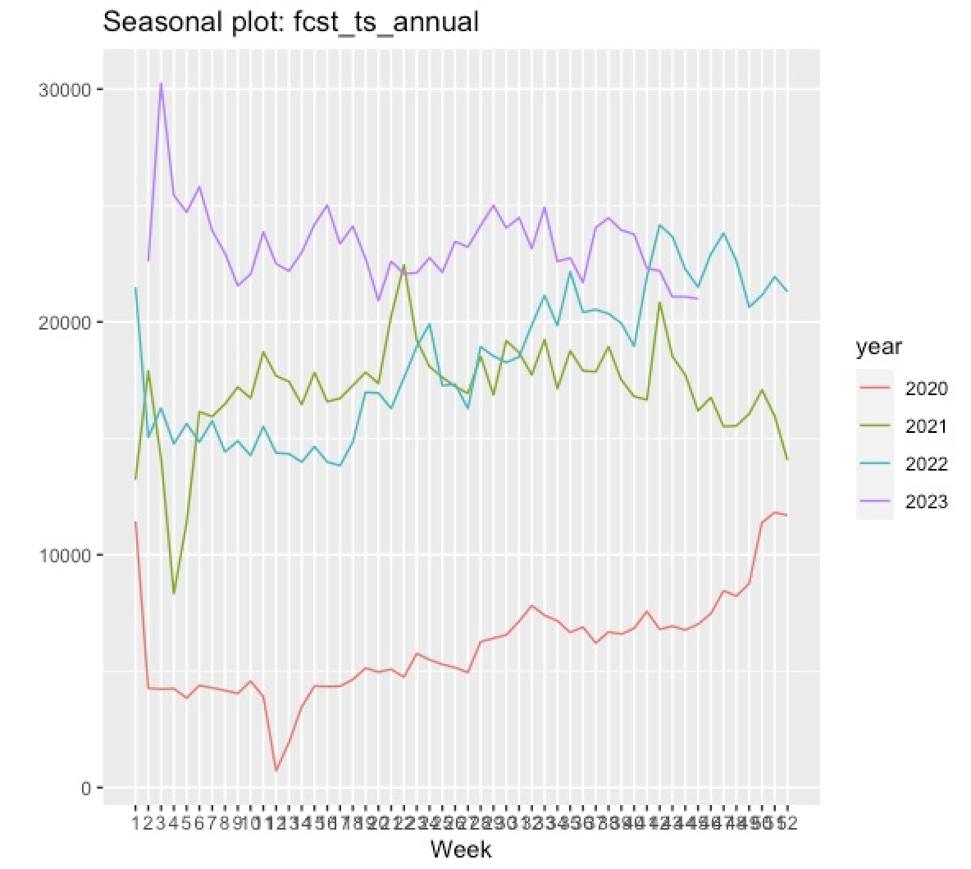
RESULTS – CHAT
Exploratory Data Analysis
Seasonal plot shows volume fluctuations from January 5, 2020, to October 29, 2023.
Notable patterns hint at a yearly cycle with regular ups and downs. Observing the weeks like March 15, 2020, and December 6, 2020, evidently shows unusual spikes.
Overall, there's a consistent upward trend, especially post-mid-2020, indicating a general increase in volume over time.

Slide 18
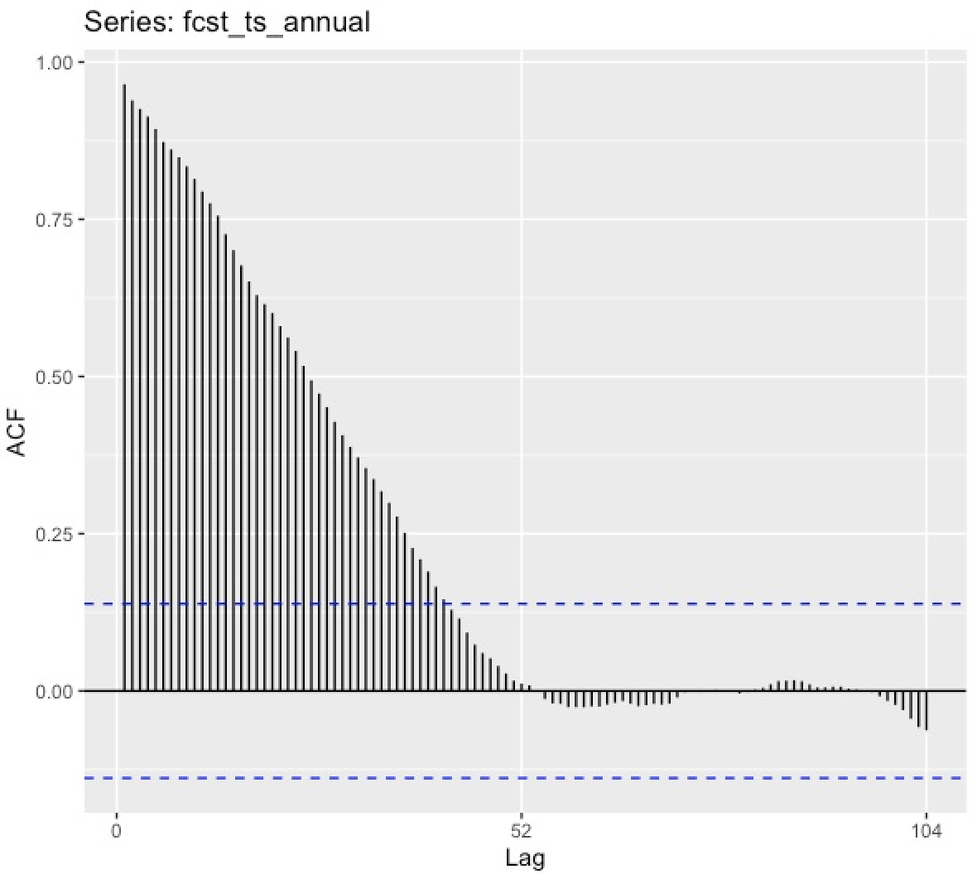
RESULTS – CHAT
Exploratory Data Analysis
Autocorrelation function (ACF) shows a strong positive correlation at lag 0 (1.000), indicating a perfect correlation with itself.
As the lag increases, the autocorrelation gradually decreases, suggesting a positive correlation between observations and their previous values.
The values remain positive throughout, indicating a consistent positive relationship between the time series and its lagged values at different time points.

Slide 19
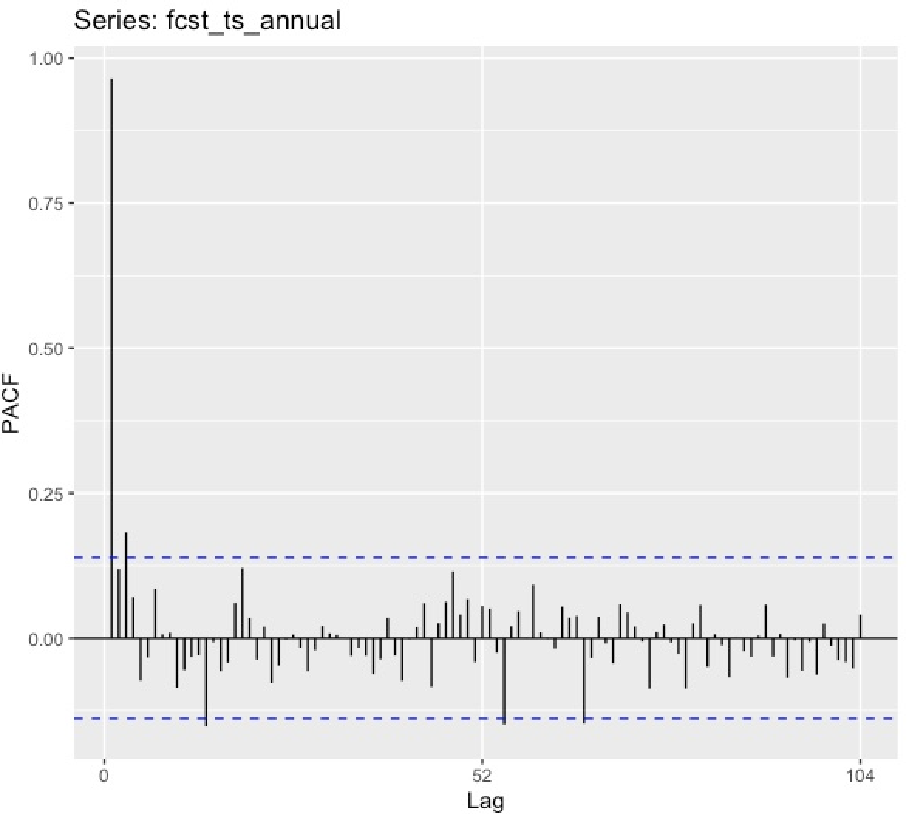
RESULTS – CHAT
Exploratory Data Analysis
Partial autocorrelation function (PACF) for the 'fcst_ts_annual' time series indicates significant correlations at the initial lags, especially at the first lag (0.965) and a few subsequent lags.
PACF values then become less significant as the lag increases, with occasional fluctuations. This suggests a potential autoregressive (AR) component in the time series, particularly at the first lag.

Slide 20
RESULTS – CHAT
Analysis of Results
Model | Data | MAPE | RMSE | AIC
Naive | Train | 10.606627 | 1,464.891 | Naïve does not involve estimating parameter or selecting model, thus no AIC.
 | Test | 7.865943 | 2,450.915
ETS | Train | 10.237256 | 1,419.979 | 3,058.398
 | Test | 7.915841 | 2,461.794
ARIMA | Train | 10.094787 | 1,322.626 | 2,679.358
 | Test | 8.630959 | 2,645.74
ARIMAX | Train | 10.2086 | 1,321.669 | 2,681.131
 | Test | 7.825297 | 2,478.214
Overall, both ARIMA and ARIMAX outperformed Naïve in MAPE metric, with ARIMAX showing a slight advantage in testing accuracy. It shows that the exogenous variable that represents launches and events, greatly affects the behavior of the model. As a general interpretation, the lower the values, the more accurate the model is.

Slide 21
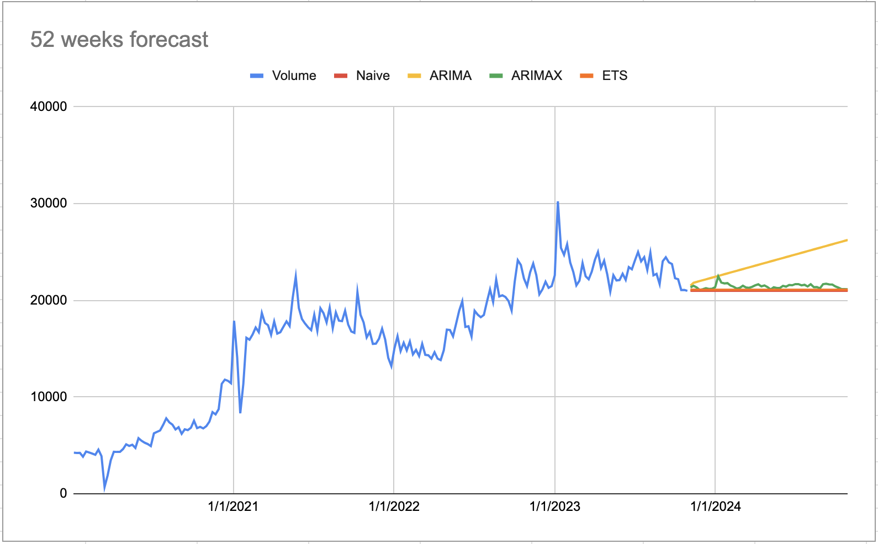
RESULTS – CHAT
Analysis of Results
Naive model, serving as a baseline, simply relies on the last observation thus not a good sole basis.
In contrast, the ARIMA model demonstrates an upward forecast, raising concerns about potential over forecasting in the long run.
ARIMAX model facilitates a more gradual approach to ramping up and down agent headcounts.

Slide 22
RESULTS – CHAT
Analysis of Results
In the end, adopting the ARIMAX model aligns with optimal workforce planning for English chat support.
It ensures a more accurate designation of agents and supports a well-structured, week-by-week headcount plan based on the anticipated volumes.
This approach enhances adaptability to fluctuations in demand and enables a more balanced and efficient staffing strategy, addressing the challenges associated with both high and low forecasting situations.

Slide 23
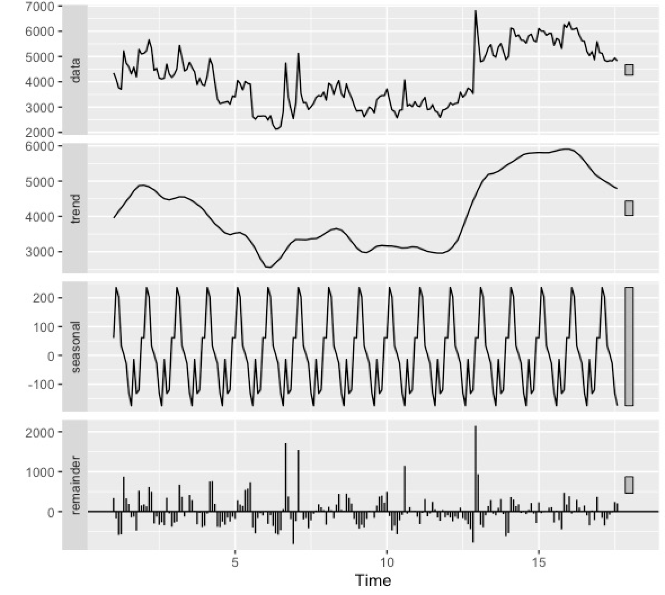
RESULTS – EMAIL
Exploratory Data Analysis
Graph shows fluctuations in the data volume with varying seasonal patterns. Interestingly, July consistently shows a negative seasonal effect, reaching -174.87, indicating a regular decline, while January consistently shows a positive seasonal effect, reaching 60.45, indicating a regular increase.
Trend component reveals the overall trajectory of the data shows a rising trend. For instance, trend values increase from 4147.614 to 5909.545 between March of year 1 and December of year 15, indicating a consistent rise in the data over the observed period of time.

Slide 24
RESULTS – EMAIL
Exploratory Data Analysis
On the other hand, the remainder, or outlier component, captures unexplained fluctuations in the data. Positive or negative remainder values highlight periods with unexpected variations not explained by the seasonal and trend components.
Also, May of year 5 shows a notably high remainder at 543.996, signifying an unexpected increase, while August of year 8 has a remainder of -399.572, indicating an unexpected decrease.

Slide 25
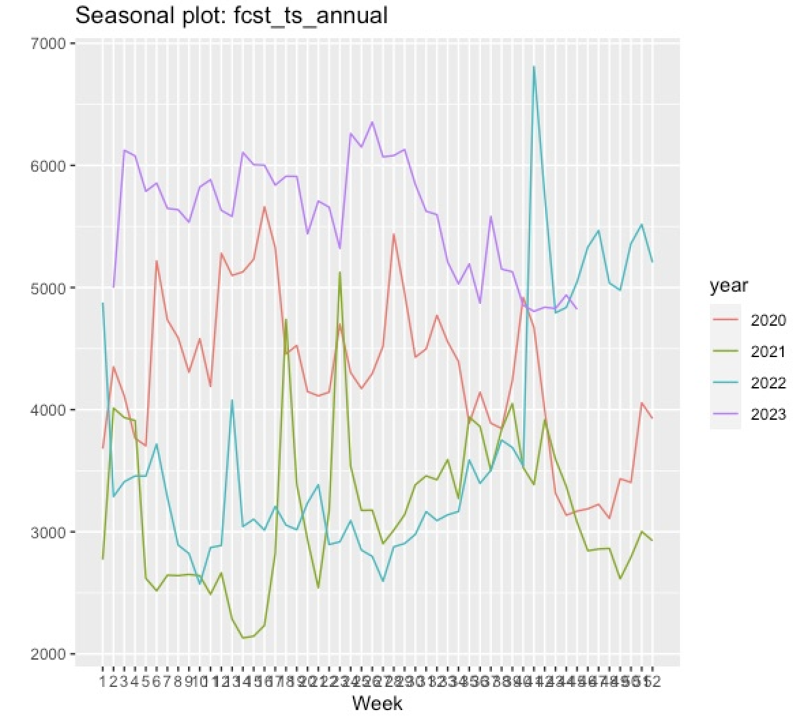
RESULTS – EMAIL
Exploratory Data Analysis
Seasonal plot indicates recurring patterns in weekly volumes, with consistent peaks and troughs (dip and spikes). End-of-year peaks suggest a seasonal surge.
For example, the weekly volume spike in the week of October 2, 2022, at 6809, stands out as a notable datapoint, reflecting a significant deviation from the usual trend in the data.
Over-all trend shows a gradual increase, with occasional deviations while outliers may be influenced by external factors too. As observed, periods of changing seasonal behavior are notable particularly in late 2022 and early 2023.

Slide 26
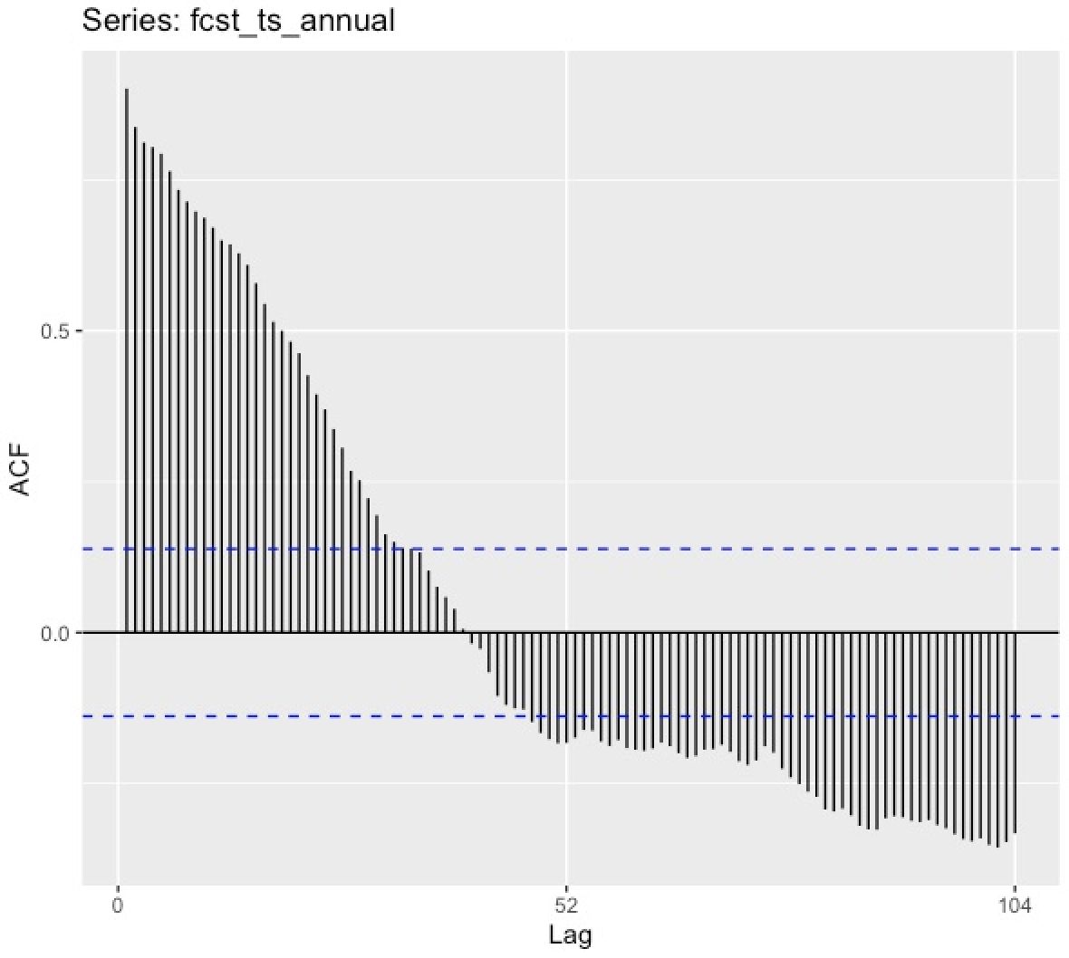
RESULTS – EMAIL
Exploratory Data Analysis
Same from the behavior of the chat data, the autocorrelation function (ACF) shows a strong positive correlation at lag 0 (1.000), indicating a perfect correlation with itself.
Significant autocorrelation peaks at lags of 52, indicating a strong annual seasonality in the weekly dataset. This means there's a recurring pattern every 52 weeks.
No significant autocorrelation is observed at other lags, emphasizing the pronounced yearly cycle. For example, a peak at lag 52 implies correlation between values at the same week in different years.

Slide 27
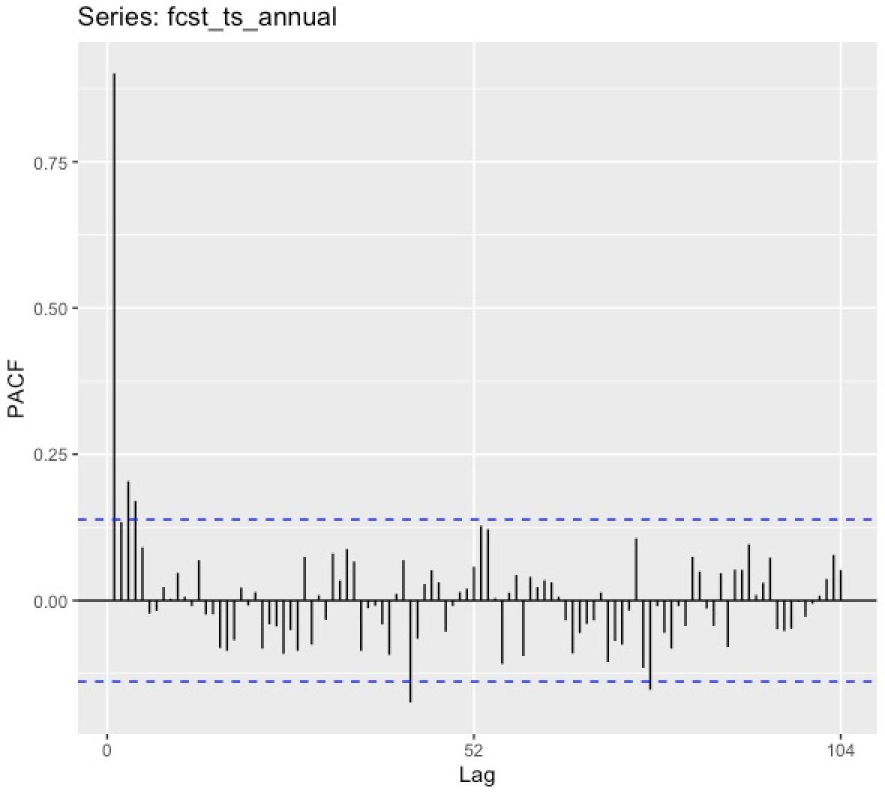
RESULTS – EMAIL
Exploratory Data Analysis
Partial autocorrelation function (PACF) for the 'fcst_ts_annual' time series displays a significant spike at lag 1, indicating a strong partial autocorrelation at this lag.
This suggests that the current week's observation is highly dependent on the observation from the previous week.
Other lags do not show significant partial autocorrelation, emphasizing the immediate week's influence on the data.

Slide 28
RESULTS – EMAIL
Analysis of Results
Model | Data | MAPE | RMSE | AIC
Naive | Train | 8.513672 | 539.2571 | Naïve does not involve estimating parameter or selecting model, thus no AIC.
 | Test | 12.3363 | 844.3162
ETS | Train | 8.621981 | 520.1485 | 2,745.061
 | Test | 10.508928 | 844.3162
ARIMA | Train | 8.334973 | 502.3315 | 2,735.145
 | Test | 9.868369 | 669.414
ARIMAX | Train | 8.615413 | 499.6411 | 2,375.048
 | Test | 11.322857 | 779.8292
ARIMAX model, incorporating exogenous variables, shows a training set MAPE of 8.61%, RMSE of 499.64, its testing set demonstrates a MAPE of 11.32% and RMSE of 799.83 while the AIC is 2375.05.
Comparatively, both ARIMA and ARIMAX outperform the Naive and ETS method on the testing set in terms of RMSE metric. As an evaluation, the lower AIC for ARIMAX suggests a better model fit compared to ARIMA.
Overall, ARIMAX emerges as the more accurate forecasting model, especially when considering external factors.

Slide 29
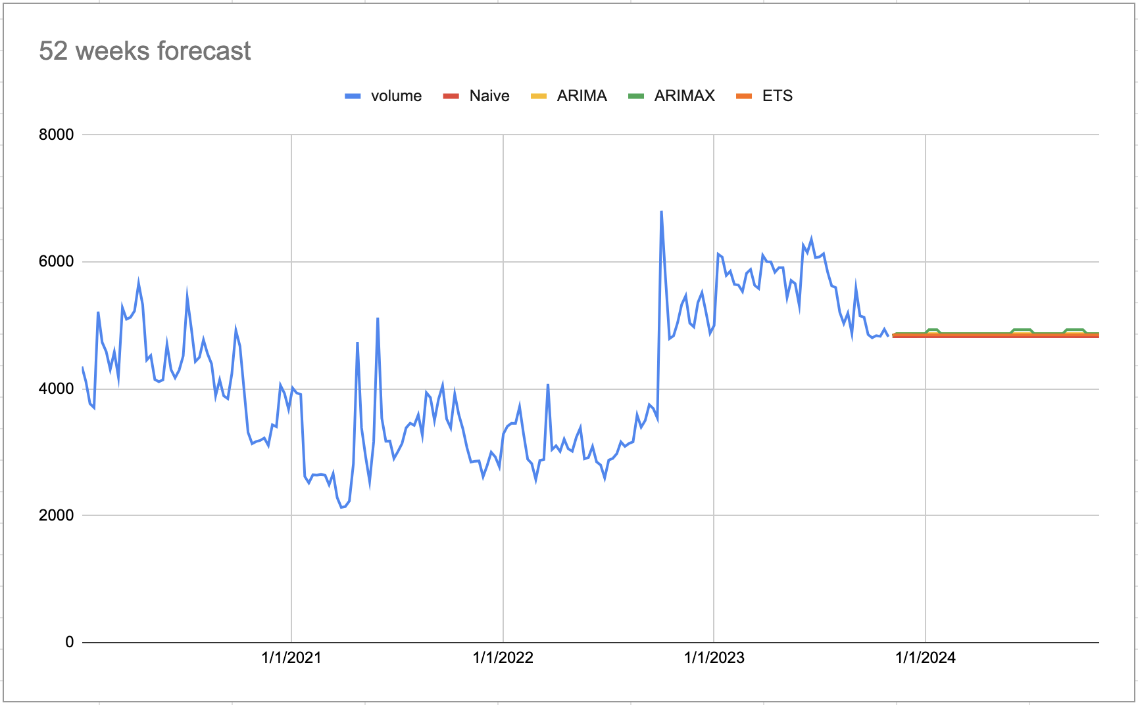
RESULTS – EMAIL
Analysis of Results
Results of the analysis shows that email behavior across four models indicates slight variations in their patterns.
Assessment done leads to the conclusion that the ARIMAX model still outperforms the other three as shown on the accuracy metrics in the model evaluation.

Slide 30
RESULTS – EMAIL
Analysis of Results
Graph shows that email data behavior is quite stable and implies a calm and manageable nature, with no significant adjustments required.
Observation also highlights lower volumes in email compared to chat, which aligns with the reasonable assumption that the resolution turnaround time for email tickets is slower than chat.
This also indicates that there is a stable staffing for agents handling emails and that can help them allocate time with other training that is necessary for upskilling. Moreover, stable volumes ease staffing concerns.

Slide 31
4
SUMMARY AND CONCLUSION

Slide 32
SUMMARY AND CONCLUSION
This paper presents time series models that leverage structured contextual data, such as events and launches, to enhance the accuracy and efficiency of workforce planning, reducing the reliance on subjective judgment.
We applied the proposed time series models to forecast volumes of YouTube complaint tickets submitted through email and chat data for 200 weeks (January 2020 to October 2023). These forecasts were generated for subscribers with English as the primary language on YouTube.
Analysis revealed a significant disparity in ticket volume, with email exhibiting notably lower levels compared to chat. This finding suggests a potential association between communication channel and user behavior. With the slower expected turnaround time associated with email potentially discouraging user preference, leading to a preference for the faster and real-time nature of chat interactions.

Slide 33
SUMMARY AND CONCLUSION
Models considered in this paper are Naïve, ETS, ARIMA and ARIMAX. While some variations in behavior patterns were observed across the four models employed, a comprehensive evaluation based on accuracy metrics revealed that the ARIMAX model consistently outperformed the others. We find that adding exogenous variables like launches and events improves the predictability of the model.
Analysis reveals a high degree of stability in email data behavior, suggesting a predictable and manageable forecasting environment, potentially requiring minimal adjustments to established models. Stable email ticket volume presents an opportunity for efficient resource allocation, enabling agents to dedicate time to essential upskilling and training initiatives, ultimately enhancing their capabilities.

Slide 34
5
RECOMMENDATION

Slide 35
RECOMMENDATION
Extending to other forecasting models can be recommended and comparing this to the aforementioned models in this study. Neural Networks, ETSX (Error, Trend and Seasonal with Exogenous variables) method and Long Short-Term Memory (LSTM) are good candidates for future study.
Enriching the dataset with further data points, such as complaint type, problem category, resolver group, timestamps, and even resolution times, could significantly enhance the granularity and comprehensiveness of the analysis.
A further research direction could involve investigating the broader organizational impact of the forecasting model. This could include examining potential synergies with other customer-facing solutions, such as chatbots and sentiment analysis of chats/emails, to optimize complaint handling processes.
Lastly, there is also a potential for identifying and understanding the customer satisfaction after the deployment of the model. This may be helpful in scoping the full impact of the forecast models as this will incorporate the view of customers, in terms of waiting time or issue resolution, rather than the view of the company and employees only. Given that the objective of workforce planning is also to provide better services / resolutions to customers / users given the adequate manpower in handling these ticket issues.

Slide 36
6
REFERENCES

Slide 37
REFERENCES
[1] Cotten, A. (2007). Seven Steps of Effective Workforce Planning, Human Capital Management Series, pp. 9 – 23
[2] Girotra, R. (2022). Workforce Planning using Time Series [Master of Science in Computer Science - Data Science dissertation, Trinity College Dublin]. https://publications.scss.tcd.ie/theses/diss/2022/TCD-SCSS-DISSERTATION-2022-070.pdf
[3] Ibrahim et al (2016). Modeling and Forecasting Call Center Arrivals: A Literature Survey. https://www.iro.umontreal.ca/~lecuyer/myftp/papers/arrivals-survey15.pdf
[4] Anggraeni,W. Vinarti, R., Kurniawati, Y. (2015). Performance Comparisons Between ARIMA and ARIMAX Method in Moslem Kids Clothes Demand Forecasting: Case Study. Procedia Computer Science. Volume 72, 2015, pp. 630-637
[5] Rabbi, F., Tareq, S., Islam, M., Chowdhury, A., Kashem, M. (2020). A Multivariate Time Series Approach for Forecasting of Electricity Demand in Bangladesh Using ARIMAX Model. 2020 2nd International Conference on Sustainable Technologies for Industry 4.0 (STI).
[6] Koutsandreas, D., Petropoulous, F., Spiliotis, E., Assimakopoulos, V. (2021). On the selection of forecasting accuracy measures. Journal of the Operational Research Society.
[7] Fildes, R., & Goodwin, P. (2007). Against your better judgment? how organizations can improve their use of management judgment in forecasting. Interfaces, 37(6), 570–576.
[8] Kolassa, S., & Martin, R. (2011). Percentage errors can ruin your day (and rolling the dice shows how). Foresight: The International Journal of Applied Forecasting, 23, 21–27.

